Slide 1
Cyber Hygiene Tools
*©Aadhaar Koul
Student at
Model institute of Engineering and technology

Slide 2
*Copyright Information
This Presentations is protected by copyright laws . Reproduction and distribution of the presentation without written permission of the sponsor is prohibited .
© Model institute of engineering and technology.

Slide 3
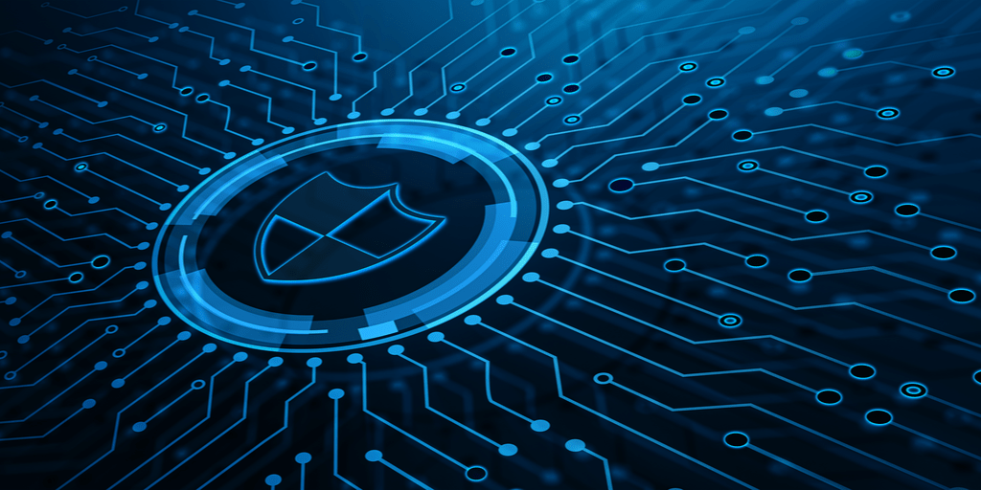
*Copyright Information
This Presentations is protected by copyright laws . Reproduction and distribution of the presentation without written permission of the sponsor is prohibited .
© Model institute of engineering and technology.
Overview

Slide 4
Basic Requirements
Functionalities and Abilities

Slide 5
1. Install reputable antivirus and malware software. ... 2. Use network firewalls. ... 3. Update software regularly. ... 4. Set strong passwords. ... 5. Use multi-factor authentication. ... 6. Employ device encryption. ... 7. Back up regularly. ... 8. Keep your hard drive clean. 9. Secure your router

Slide 6
Innovations and Techniques
Based on AI / ML and Web 3.0

Slide 7
AI Based
Threat response time
Staffing capacity
Adaptability
Data privacy classification and compliance
Predictive forecasting
ML Based
Human efficiency with repeated activities
Threat alert fatigue Handling
Data clustering
System / User performance security profiles
AI and ML
Human error in configuration
New threat identification and prediction
Possibility synthesis / User behavior security profiles
Behavior-based bot blocking
Web 3.0
Information Authenticity
Manipulation of Data
Ecosystem of distributed applications
Controlled Identity risks
Security In AI Enabled Environments

Slide 8
AI based Tools
Till Now

Slide 9
Tool | Innovation | Avaliability | Links
(CHAI) Cyber Hygine AI | Security In AI Enabled Environments | Commercial and Domestic use | Details of Grant - https://gow.epsrc.ukri.org/NGBOViewGrant.aspx?GrantRef=EP/T026812/1
AI to improve Cyber security by Alberto Lugo | Detection and Prediction of New, Complex Threats | Commercial Use Only | https://invidgroup.com/applying-machine-learning-and-ai-to-improve-cyber-security/
Sopho’s Intercept X Tool | Endpoint Security Using EDR , XDR | Commercial Use Only | https://www.sophos.com/en-us/products/endpoint-antivirus
Darktrace Antegena | Takes targeted, proportionate actions in response to cyber-attacks, without disrupting day-to-day business. | Commercial and Domestic use | https://venturebeat.com/2022/02/11/darktrace-on-where-security-ai-goes-next-turning-the-tables-on-attackers/
IBM’s Qradar Advisor | Detect and eliminate threats faster with XDR suite | Commercial and Domestic use | https://www.ibm.com/in-en/qradar?

Slide 10
Tool | Innovation | Availability | Links
Vectra’s Congnito | See and stop threats across hybrid and multi-cloud enterprises | For commercial use only | https://www.vectra.ai/about/company
Symmantic’s Targertted Attack Analysis (TAA) | Cloud-based Artificial Intelligence for Enterprise-Focused Advanced Threat Protection | For commercial use only | https://techdocs.broadcom.com/us/en/symantec-security-software/endpoint-security-and-management/endpoint-detection-and-response/4-6/Settings/enabling-the-targeted-attack-analytics-v126152861-d38e48931.html
Cybersec TK | Personalised configuration for a specific task | commercial and domestic use | https://gcatoolkit.org/

Slide 11
ML based Tools
Till Now

Slide 12
Tool | Innovation | Availability | links
bioHAIFCS | The evolutionary prevention system from SQLinjection (ePSSQLI) , (HESADM) , (ECISMD) | Army forces and cyber intelligence / Forensics | https://www.academia.edu/37219947/bioHAIFCS_pdf
Cyber security Tool Kit (STIK) | Personalised configuration for a specific task | commercial and domestic use | SMB , CISA , GCA Official Sites
Cognto by Vectra | See and stop threats across hybrid and multi-cloud enterprises | US Defense Advanced Research Projects Agency (DARPA) | https://www.vectra.ai/about/company
Defplore X | Deep Vulnerabilty Assessment tool | None | ....
String Sifter | Malware analysts routinely use the Strings program during static analysis in order to inspect a binary's printable characters | For Commercial and Domestic use | https://www.fireeye.com/blog/threat-research/2019/09/open-sourcing-stringsifter.html
Sopho’s Intercept X Tool | Endpoint Security Using EDR , XDR | Commercial Use Only | https://www.sophos.com/en-us/products/endpoint-antivirus

Slide 13
Web 3.0 based Tools
Till Now

Slide 14
Tool | Innovation | Availability | Links
EthereumBook | smart contract programming and Anti Programming Protection | For commercial and Domestic use | https://github.com/ethereumbook/ethereumbook/blob/develop/09smart-contracts-security.asciidoc
Apriorit Smart Contract Solution | Smart Contract Hijacking Detection and protection | For commercial use only | https://www.forbes.com/sites/forbestechcouncil/2021/11/10/five-ways-you-can-strengthen-your-smart-contracts-immunity-to-cyberattacks/?sh=3bfdd0907c56
NFSea.tools | Rug Pull Detection and Protection with real time NFT Monitoring | For commercial and Domestic use | https://nfsea.tools/features
String Sifter | AI Detection and Protection from ICE PHISHING. | For Commercial and Domestic use | https://www.fireeye.com/blog/threat-research/2019/09/open-sourcing-stringsifter.html
Symmantic’s Targertted Attack Analysis (TAA) | Cloud-based Artificial Intelligence for Enterprise-Focused Advanced Threat Protection | For commercial use only | https://techdocs.broadcom.com/us/en/symantec-security-software/endpoint-security-and-management/endpoint-detection-and-response/4-6/Settings/enabling-the-targeted-attack-analytics-v126152861-d38e48931.html
Sopho’s Intercept X Tool | Endpoint Security Using EDR , XDR | commercial use only | https://www.sophos.com/en-us/products/endpoint-antivirus

Slide 15
SWOT Analysis
STRENGTHS
Constant Improvements
Large Open source Communities
WEAKNESSES
Public Awareness
Paid
No Absolute Solution for One problem
S
W
Expanding the applications
Cyber Awareness Programs / Events in Schools / Colleges
OPPORTUNITIES
Chances of Vulnerabilities
Black Hats
Distribution of Malicious Programs
THREATS
O
T

Slide 16
*Copyright Information
This Presentations is protected by copyright laws . Reproduction and distribution of the presentation without written permission of the sponsor is prohibited .
© Model institute of engineering and technology.
Summary

Slide 17
Thanks!
Any questions?
You can find me at
@_aadhaar_
aadhaarkoul2002@gmail.com

